Slide 1
Mexicanidad on the Westside: Tracing the Legacy of Incomparable Servingness at Our Lady of the Lake University
Historical Timeline of OLLU

Slide 2
Beginnings & Purpose
Our Lady of the Lake University (OLLU) was established in 1895 by the Sisters of the Congregation of Divine Providence
Formerly known as Our Lady of the Lake College
All-girl high school → two-year college → four-year university
“The Sisters of Divine Providence migrated to the Westside area with the purpose of serving marginalized peoples,” per Dr. Candace Zepeda

Slide 3
Mexican American culture
OLLU has been host to various significant events highlighting their Latinx-serving identity
(1968) U.S. Commission on Civil Rights Hearing on Mexican Americans in the Southwest
(1970) Public forum on “La Raza and the Violation of Civil Rights in Texas” occurring at the OLLU campus
(2018) 50th Anniversary conference commemorating the 1968 Civil Rights commission
(2020) Chosen to house the National Institute of Mexican American History of Civil Rights

Slide 4
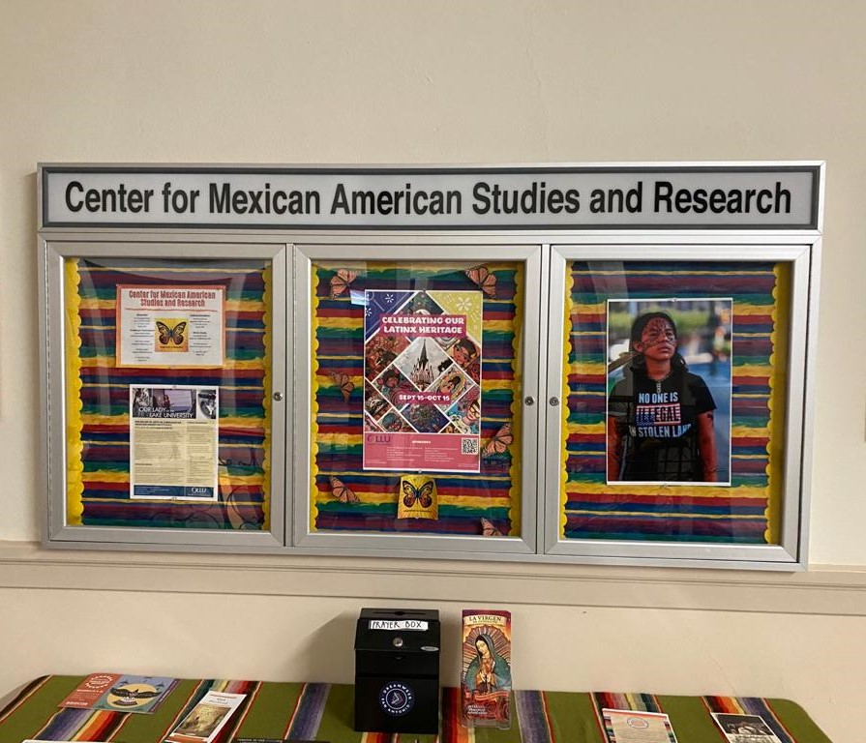
“Servingness” at OLLU
Center for Mexican American Studies & Research (CMASR)
Established in 2001
“Dedicated to drawing on our expertise as a Hispanic Serving Institution, steeped in the rich Mexican American culture and history of San Antonio’s Westside” (OLLU)
“…[S]upporting the University in fulfilling its mission as a Catholic Hispanic Serving Institution…” (OLLU)
Development of Mexican American Studies Program
BA in Comparative Mexican American Studies
Mexican American Studies Minor
Cultural Studies Minor

Slide 5
Latinx-serving Evidence
Mission & Vision Statements
Highlights 3 important ways in which the school aims to serve their students by ensuring quality, innovative learning experiences and preparing their students for success
Highlights the desire for wanting to be recognized for their knowledge in Mexican American culture
On-campus Organizations
Association of Latino Professionals for America (ALPFA)
Bilingual Education Student Organization (BESO)

